Slide 1
Binomial option pricing

Slide 2
Binomial option pricing:
Uses a binomial tree representing the possible paths followed by an underlying asset.
Is a discrete method using time steps.
Assumes no-arbitrage & risk-neutral valuation - absence of opportunities to take advantage of price differences to make a guaranteed profit with no risk

Slide 3
Call option- right To buy stock
Put option- right to sell stock
Strike price- the previously agreed price of the underlying stock at which it can be bought or sold

Slide 4
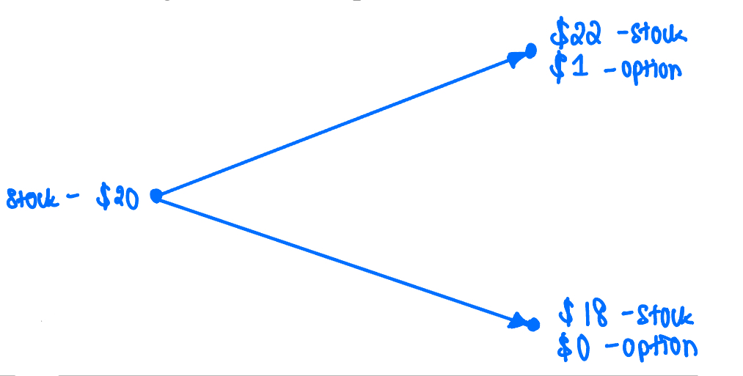
One step example

Slide 5
Generalisation for one step trees

Slide 6
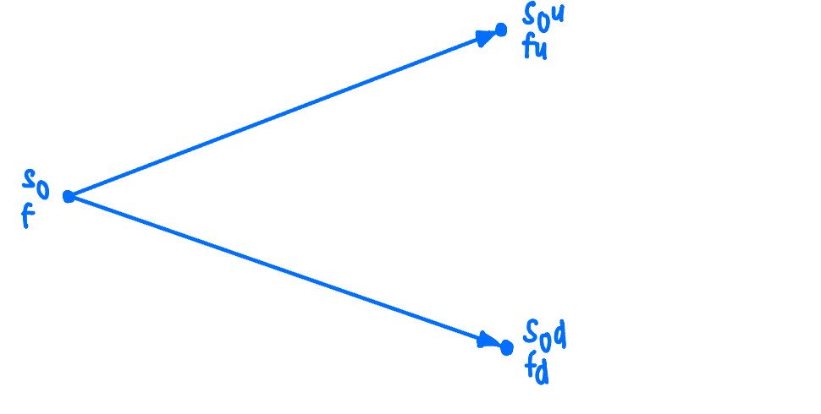
One step
S₀ - stock price
f- price of option on S₀
T- time option lasts for
S₀u- stock price up a level —> f_{u}
S₀d- stock price down a level —> f_{d}
Δ - no. of shares
r- risk free interest rate
u- multiplicative factor by which stock price increases
d-multiplicative factor by which stock price decreases

Slide 7
One step – portfolio: long Δ shares, short 1 option
Up movement→ S₀uΔ-f_{u} down movement → S₀dΔ-f_{d}
Δ= (f_{u} -f_{d} )/(S₀u-S₀d)
Present value of portfolio: (S₀uΔ-f_{u})e^{-rT} cost → S₀Δ-f
f=S₀Δ(1-ue^{-rT})+f_{u}e^{-rT}
f= e^{-rT}[pf_{u}+(1-p)f_{d}]
p=(e^{rT} -d)/(u-d)
No arbitrage argument
Notes:
Note include derivationsv

Slide 8
European vs american options

Slide 9
The example we saw was a European option
In a two-step model, the option price is always calculated by working backwards; finding the final (right hand) nodes and then using the formula to work out the earlier nodes

Slide 10
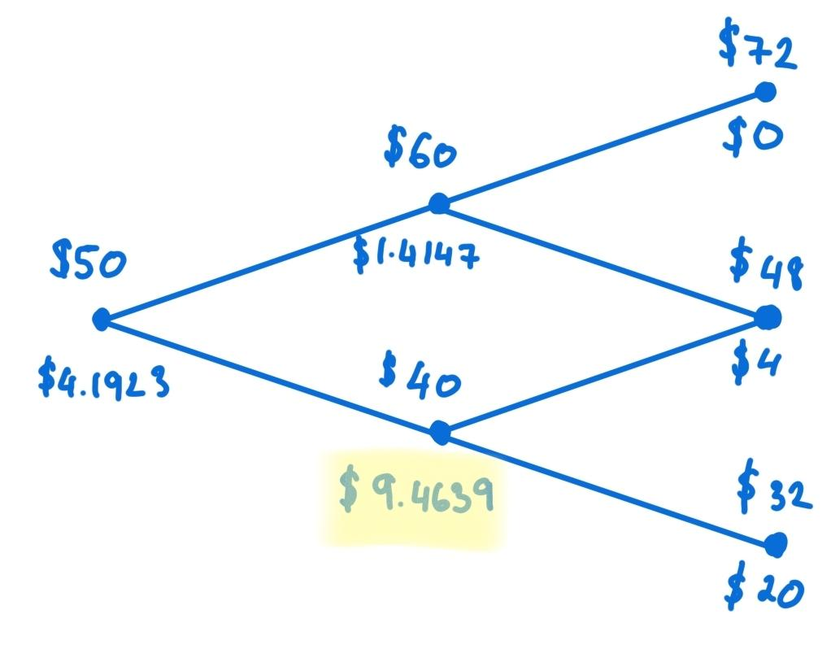
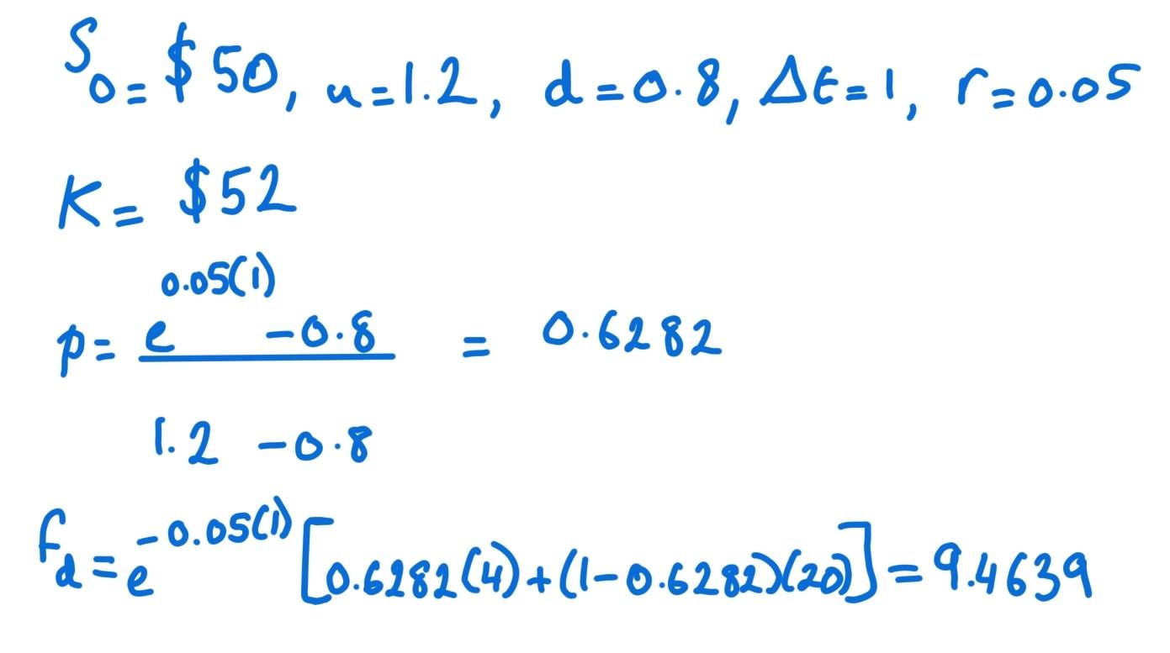
Two step put example (European Option)
9.4636
$ 9.4636

Slide 11
American options take the greater of the value of the option given by the formulas and the payoff from “early exercise”
“Early exercise” refers to the right to exercise an option before its expiration date; checking at each node whether the exercise payoff is greater than the formula value

Slide 12
At f_{d} we calculated $9.4636
Strike price = $52
Exercise payoff: $52-$40=$12
$12 > $9.4636 so early exercise is used because exercising now gives more than holding the option

Slide 13
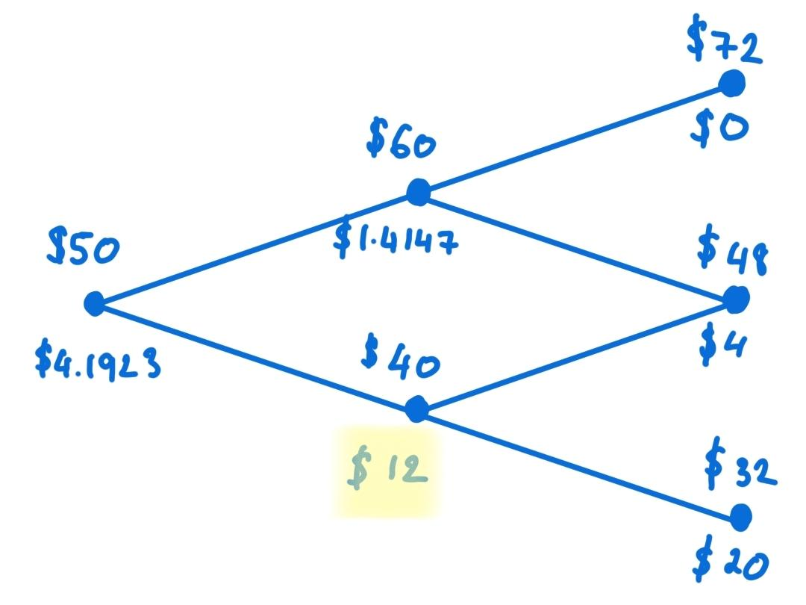
Two step put example (American Option)

Slide 14
Real world vs risk-neutral world

Slide 15
We price the option in the risk-neutral world
We discover that:
The expected return on a stock is the risk-free rate.
The discount rate for the expected payoff is the risk-free rate.
Since we assume no-arbitrage the real world and risk-neutral world option prices must be the same.

Slide 16
Expected Return (E) = Risk-Free Interest Rate (r) + Risk Premium (x)
In a risk-neutral world risk premium is zero, so E=r
So, in binomial option pricing we can choose:
p to be the risk-neutral probability of an up movement.

Slide 17
Denote E(S_{T}) as the expected stock price, then
E(S_{T}) = pS₀u + (1-p)S₀d = pS₀(u-d) + S₀d
Substitute p = (e^{rT} - d)/(u-d), so
E(S_{T}) = S₀e^{rT}
So, the stock price grows, on average, at the risk free rate.

Slide 18
The binomial model predicts stock prices with up & down movements.
As the number of steps increases ΔT->0, the binomial model converges to a continuous-time model known as Black-Scholes.
The Black-Scholes Model is used for pricing European options.
The basis for this is related to brownian motion and the random paths of stock prices, whose log-returns are normally distributed.

Slide 19
Black-Scholes model

Slide 20
The Binomial Model is discrete, whereas the Black-Scholes Model is Continuous.
In the Binomial Model the stock price either goes up or down by a set percentage, whereas in the Black-Scholes Model the stock price is random and follows geometric brownian motion.

Slide 21
Assumptions:
Log-normal distribution of stock prices.
Constant volatility and risk-free rate.
No dividends.
Continuous trading and hedging.
No early exercise

Slide 22
IMPLEMENTING the binomial Option model

Slide 23
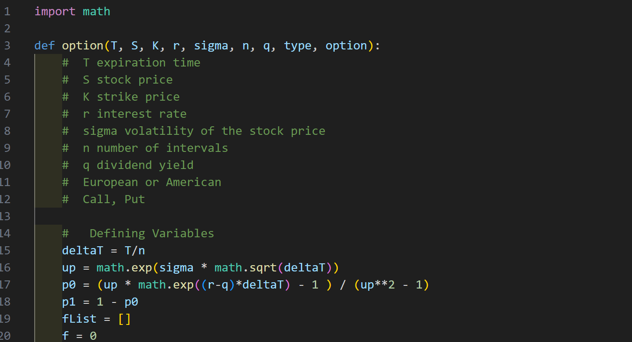
Defining Variables
import math
def option(T, S, K, r, sigma, n, q, type, option):
# T expiration time
# S stock price
# K strike price
# r interest rate
# sigma volatility of the stock price
# n number of intervals
# q dividend yield
# type: "European" or "American"
# option: "Call" or "Put"
...
# Defining Variables
deltaT = T/n
up = math.exp(sigma * math.sqrt(deltaT))
p0 = (up * math.exp((r-q)*deltaT) - 1 ) / (up**2 - 1)
p1 = 1 - p0
if not 0 <= p0 <= 1:
raise ValueError("arbitrage: risk-neutral probability outside [0, 1]; increase n or check r, q, sigma")
fList = []
f = 0

Slide 24
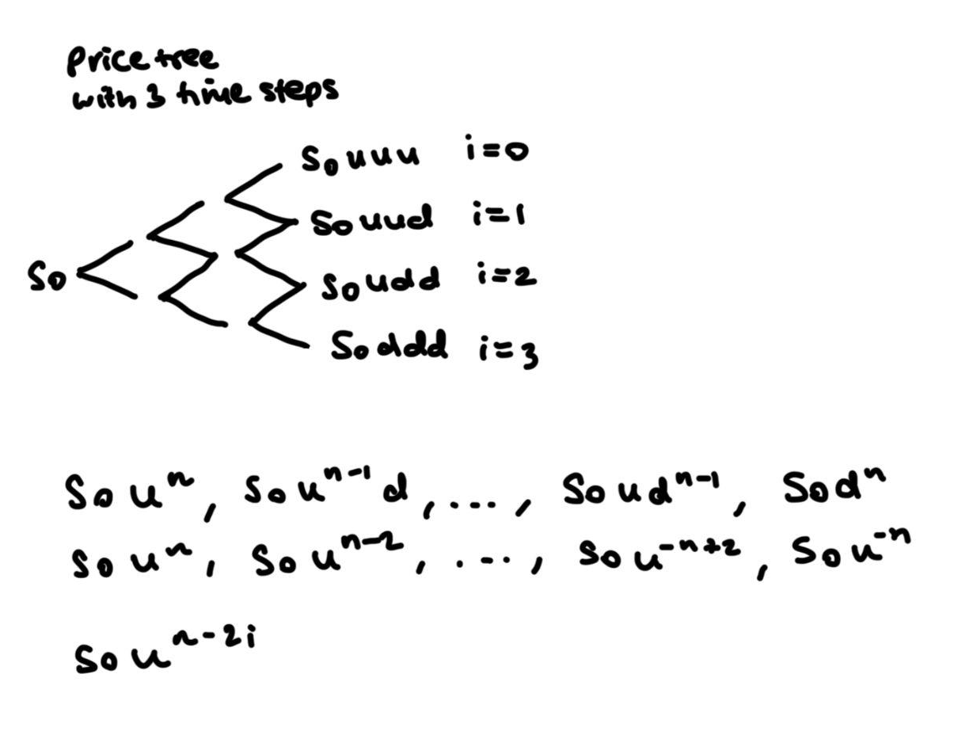
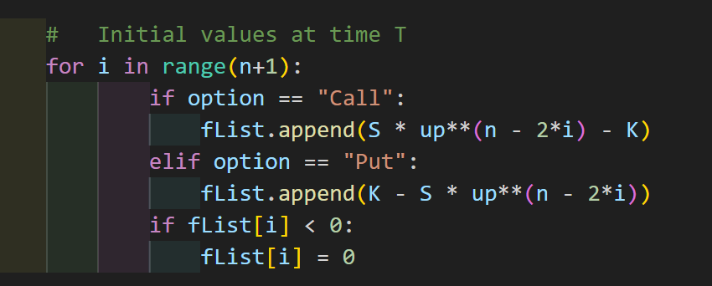
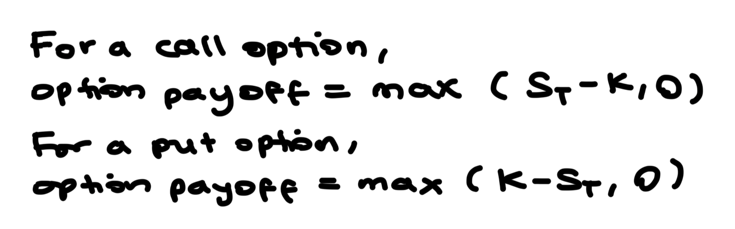
Calculating Final Option Prices

Slide 25
Calculating Expected Option Price
if type == "European":
for m in range(n+1):
f += math.exp(-r * T)*((math.factorial(n)//(math.factorial(m)*math.factorial(n-m))) * (p0**(n-m)) * (p1**(m)) * fList[m])
return f

Slide 26
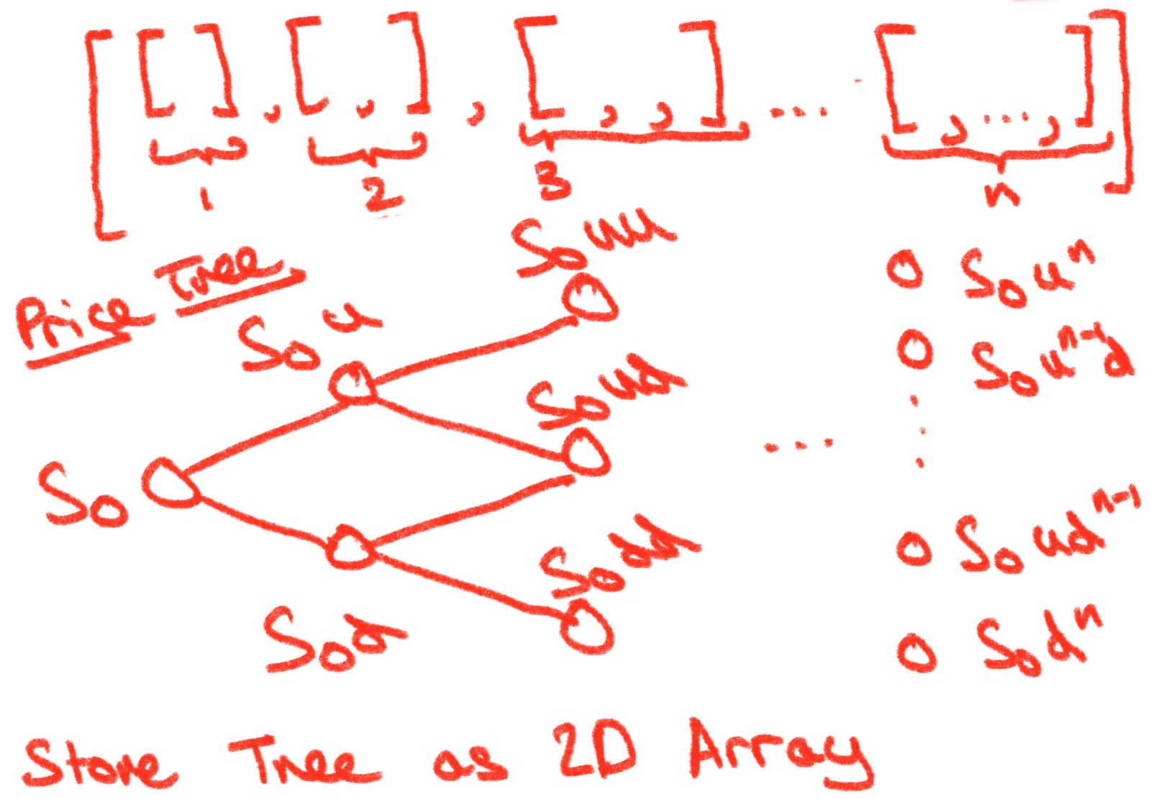
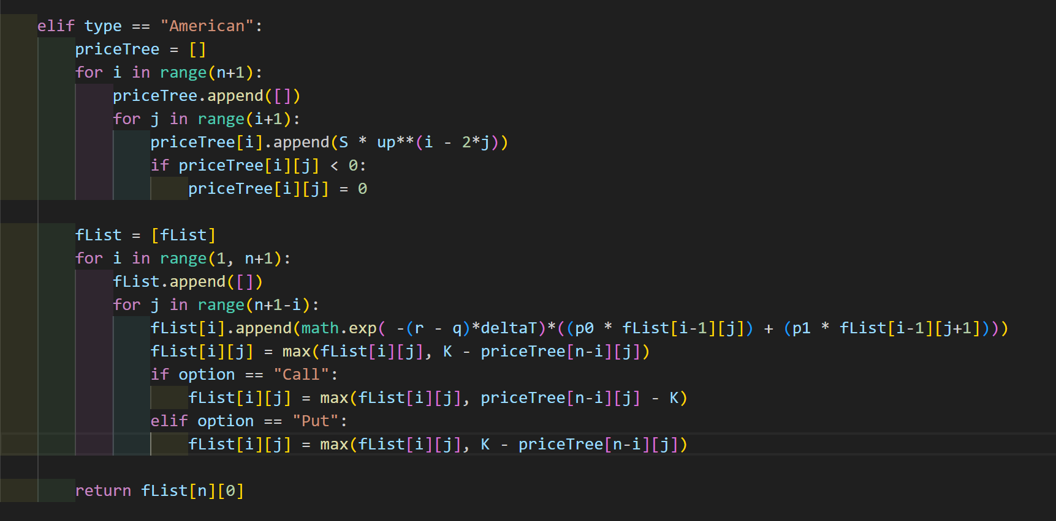
Calculating Intermediary Values in Price Tree
elif type == "American":
priceTree = []
for i in range(n+1):
priceTree.append([])
for j in range(i+1):
priceTree[i].append(S * up**(i - 2*j))
if priceTree[i][j] < 0:
priceTree[i][j] = 0

Slide 27
Calculating Expected Prices with Early Exercise Option
for i in range(1, n+1):
fList.append([])
for j in range(n+1-i):
fList[i].append(math.exp(-r * deltaT)*((p0 * fList[i-1][j]) + (p1 * fList[i-1][j+1])))
# Early Exercise
if option == "Call":
fList[i][j] = max(fList[i][j], priceTree[n-i][j] - K)
elif option == "Put":
fList[i][j] = max(fList[i][j], K - priceTree[n-i][j])
return fList[n][0]

Slide 28
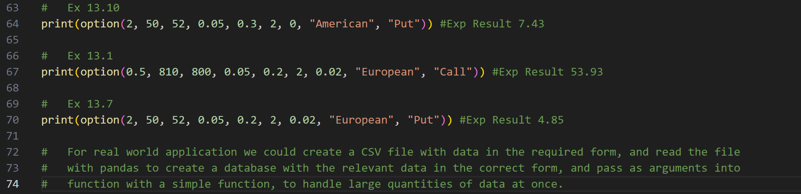
Testing Data with Real World Examples
70 # Ex 13.3
71 print(option(0.75, 31, 30, 0.05, 0.3, 3, 0, "American", "Call")) #Exp Result 4.49
72
73 # Ex 13.10
74 print(option(2, 50, 52, 0.05, 0.3, 2, 0, "American", "Put")) #Exp Result 7.43
75
76 # Ex 13.1
77 print(option(0.5, 810, 800, 0.05, 0.2, 2, 0.02, "European", "Call")) #Exp Result 53.39
78
79 # Ex 13.7
80 print(option(2, 50, 52, 0.05, 0.2, 2, 0.02, "European", "Put")) #Exp Result 4.66
81
82 # For real world application we could create a CSV file with data in the required form, and read the file
83 # with pandas to create a database with the relevant data in the correct form, and pass as arguments into
84 # function with a simple function, to handle large quantities of data at once.

Slide 29
THANK you
Does anyone have any questions?

